Slide 1
Managing Information Technology Resources ITWS 4310
Moore’s Law, Disruptive Technologies, Economics of IT and Cost-Benefit Analyses
September 10, 2018

Slide 2
Managing IT Resources Class Outline: Mon, Sept 10, 2018
Project Teams submit Term Project Proposals on Thurs Sept 13 by EOD – 11:59 PM
Quiz on Ch 5, Ch 6, Project, Current Events?
Current Event Articles
Chapter 5: Moore’s Law and More
Chapter 6: Disruptive Technologies
Economics of IT plus Cost-Benefit Analyses
Meet with Project Teams about Project Selection

Slide 3
Managing IT Resources Faculty Contact and Office Hours
Matthew Grill: mgrill.rpi@gmail.com
Office – Lally Hall 315
Office Hours – Tuesdays 11 AM – Noon
Jeff Miner: minerj@rpi.edu
Office – Folsom Library Room 233A
Office Hours – By appointment
Gaurang Prasad: prasag@rpi.edu
Office – ITWS Lounge (Lally 205)
Office Hours – Wednesdays 10 AM – Noon

Slide 4
MITR 2018 Term Project Teams & Seating Chart
Row 4
Row 3
Row 2
Row 1
Front of Classroom

Slide 5
Managing IT Resources: ITWS 4310 Term Project Report Outline
Section 1: Executive Summary
Section 2: Introduction
Section 3: Client Organization and Description
Section 4: Project Team
Section 5: Problem Statement
Section 6: IS/IT Solution
Section 7: Methodology
Section 8: IS/IT Requirements
Section 9: IS/IT Design
Section 10: Cost-Benefit Analysis
Section 11: Project Plan/Schedule/Resources
Section 12: Post-Turnover Plan
Section 13: Results and Client Feedback
Section 14: Conclusions
Project Proposal:
due Sept 13 by EOD: 11:59 PM

Slide 6
Client/Project Criteria
Client must be “real”; can be a company, a non-profit organization, government agency, sole proprietorship, etc.
Project must involve implementing an information system or technology solution that addresses a business need for the client.
Scope must be more than just a web presence; can include database, content management, data analytics, hardware, process reengineering, workflow automation, etc.
Client and scope must be approved by an instructor

Slide 7
Kahoot! Quiz
Not today!
Take 15 minutes to meet with your team
If time allows at the end of class you’ll be able to meet again

Slide 8
Technology Current Events: “As Google Turns 20, Questions Over Whether It's Too Powerful”, Billboard, Sept 7, 2018. https://www.billboard.com/articles/business/tech/8474130/google-turns-20-too-powerful
Twenty years after Larry Page and Sergey Brin set out to organize all of the internet's information, the search engine they named Google has morphed into a dominating force in smartphones, online video, email, maps and much more.
That resounding success now has regulators and lawmakers around the world questioning whether the company has become too powerful as its ubiquitous services vacuum up sensitive information about billions of people hooked on its products.
Google's search engine remains entrenched as the internet's main gateway, and its digital advertising business is on pace to generate about $110 billion in revenue this year. Much of that revenue now flows through Google's Android operating system, which powers 80 percent of the world's smartphones. Google also runs the biggest video site in YouTube, the most popular web browser in Chrome, the top email service in Gmail and the maps that most people use to get around.
Not bad for a company that started 20 years ago Friday with an initial investment of $100,000. Google and its sibling companies operating under the umbrella of Alphabet Inc. are now worth $800 billion.
Google's success often draws comparisons with Microsoft.
“Google is in the government's crosshairs,”
It all paints a picture of a company that may spend the next decade fighting to protect the empire it built during its first two decades.

Slide 9
Technology Current Events: “Where Does MoviePass Go From Here?” The Motley Fool, Sept 8, 2018. https://www.fool.com/investing/2018/09/08/where-does-moviepass-go-from-here.aspx
It's getting harder and harder to use the multiplex service, and that's playing right into the hands of the movie exhibitors that Helios and Matheson Analytics was hoping to disrupt.
The difference between the end of a movie and a MoviePass income statement is that only one of those fades to black. Things continue to be rocky for MoviePass and its publicly traded parent company Helios and Matheson Analytics (NASDAQ:HMNY). The flawed model continues to bleed red ink, and social media continues to fume about recent changes to the former multiplex-buffet operator.
The problem with third-party platforms including MoviePass and Sinemia is that you can't give away more than you take in forever. Creditors get fed up subsidizing theater binges of penny-pinching moviegoers. The model only works if you can offset the expenses, and there's no clear path to making that happen no matter how many ads you sell, data-selling deals you strike, or corporate tie-ins you square away. You need to be in a position to control costs and own the concessions that profit from an increase in traffic, and that's why AMC Entertainment(NYSE:AMC) has seen its AMC Stubs A-List platform go from zero to 260,000 members.
MoviePass and Sinemia will probably die educating the market. AMC and smaller multiplex operators will reap the benefits of subscription-hungry film buffs.

Slide 10
Chapter 5
Moore’s Law and More: Fast, Cheap Computing, and What This Means for the Manager

Slide 11
Learning objectives
Define Moore’s Law and understand the approximate rate of advancement for other technologies, including magnetic storage (disk drives) and telecommunications (fiber-optic transmission).
Understand how the price elasticity associated with faster and cheaper technologies opens new markets, creates new opportunities for firms and society, and can catalyze industry disruption.
Recognize and define various terms for measuring data capacity.
Consider the managerial implication of faster and cheaper computing on areas such as strategic planning, inventory, and accounting.

Slide 12
Advancing rates of technology

Slide 13
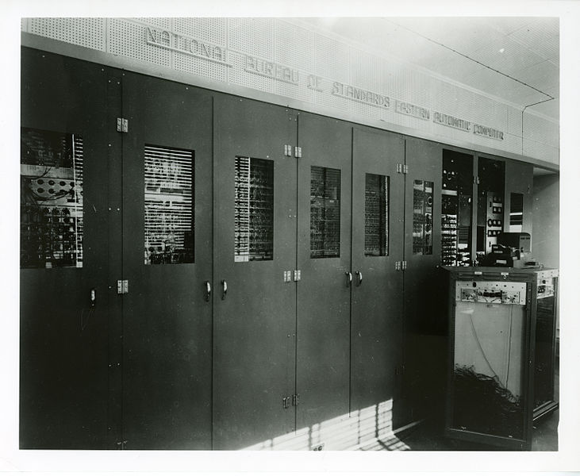
Evolution of the technological landscape
Price elasticity: Rate at which the demand for a product or service fluctuates with price change.
Evolving waves of computing:
1960s - Mainframe computers
1970s - Minicomputers
1980s - PCs
1990s - Internet computing
2000s - Smartphone revolution
2010s - Pervasive computing:
Vision of embedding low-cost sensors, processors, and communication into a wide array of products and the environment.
Allow a vast network to collect data, analyze input, and automatically coordinate collective action.

Slide 14
Moore’s Law
Power of computer chip to double every 18 to 24 months while cost stays flat.
Organizations have opportunity to buy, for the same price, twice the processing power in 1 ½ years; 4 times the power in 3 years; 8 times the power in 4 ½ years, etc.
Price-to-performance ratio will continue to decline exponentially.
Limitations with current technologies could end trend for silicon-based chips in 10 to 20 years.
Notes:
New technologies will likely allow phenomenal growth to continue.
Advances in network technologies & storage, compared to those in chip technology, even more profound.
Click picture for webcast & more about Moore’s Law to expand discussion opportunities. Some predictions were made in 1965 making
Moore quite a visionary by any standards.

Slide 15
Three Technology Growth “Laws”
Three laws that are generally accepted as governing the growth of technology:
Moore's Law: formulated by Gordon Moore of Intel in the early 70's - the processing power of a microchip doubles every 18 months; corollary, computers become faster and the price of a given level of computing power halves every 18 months.
Gilder's Law: proposed by George Gilder, prolific author and prophet of the new technology age - the total bandwidth of communication systems triples every twelve months. New developments seem to confirm that bandwidth availability will continue to expand at a rate that supports Gilder's Law.
Metcalfe's Law: attributed to Robert Metcalfe, originator of Ethernet and founder of 3COM: the value of a network is proportional to the square of the number of nodes; so, as a network grows, the value of being connected to it grows exponentially, while the cost per user remains the same or even reduces.
Source: Jim Pinto, Automation.com, April 2002

Slide 16
Computing and Communication Scale
 | Managerial Definition | Exact Amount | Perspective
1 Byte | One keyboard char | 8 bits | 1 letter or number = 1 byte
1 Kilobyte (KB) | One thousand bytes | 2¹⁰ bytes | 1 typewritten page = 2 KB
 |  |  | 1 digital book (Kindle) = approx. 500—800 KB
1 Megabyte (MB) | One million bytes | 2²⁰ bytes | 1 digital photo (7 megapixels) = 1.3 MB
 |  |  | 1 MP3 song = approx. 3 MB
 |  |  | 1 CD = approx. 700 MB
1 Gigabyte (GB) | One billion bytes | 2³⁰ bytes | 1 DVD movie = approx. 4.7 GB
 |  |  | 1 Blu-ray movie = approx. 25 GB
1 Terabyte (TB) | One trillion bytes | 2⁴⁰ bytes | Printed collection of the Library of Congress = 20 TB
1 Petabyte (PB) | One quadrillion bytes | 2⁵⁰ bytes | eBay data warehouse (2010) = 10 PB ^{[14]}
1 Exabyte (EB) | One quintillion bytes | 2⁶⁰ bytes
1 Zettabyte (ZB) | One sextillion bytes | 2⁷⁰ bytes | Amount of data consumed by U.S. households in 2008 = 3.6 ZB

Slide 17
Impacts of Rapidly Changing Price Performance of Technology
When producing products with a significant chip-based component, the semiconductors inside that product rapidly fall in value
It is great when it makes your product cheaper and opens up new markets for your firm
It can be a problem if you overproduce and have excess inventory
5-17

Slide 18
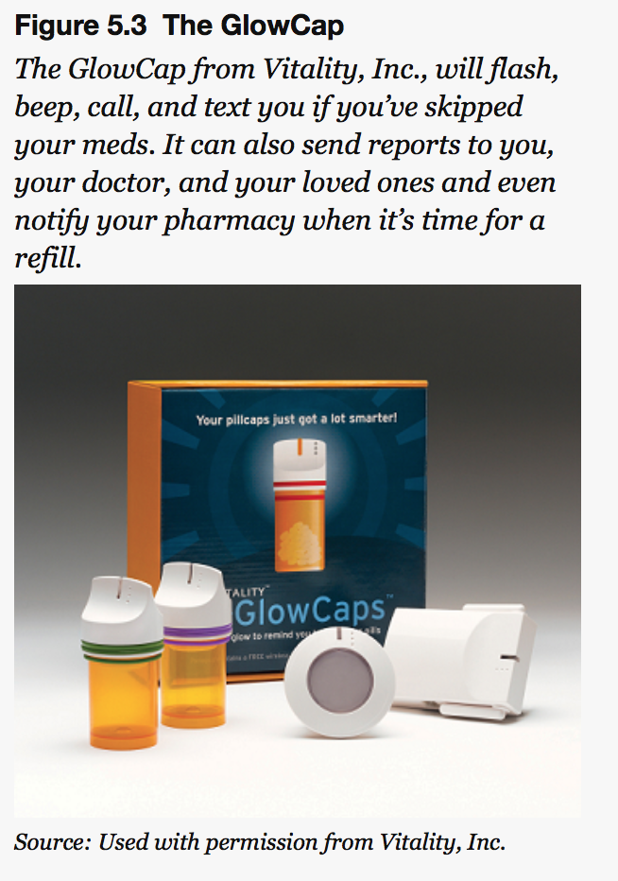
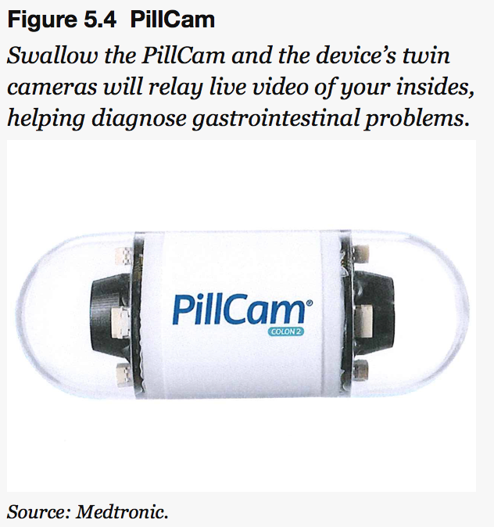
Applications of Technology
5-18

Slide 19
Learning Objectives
Describe why Moore’s Law continues to advance and discuss the physical limitations of this advancement.
Name and describe various technologies that may extend the life of Moore’s Law.
Discuss the limitations of each of these approaches.

Slide 20
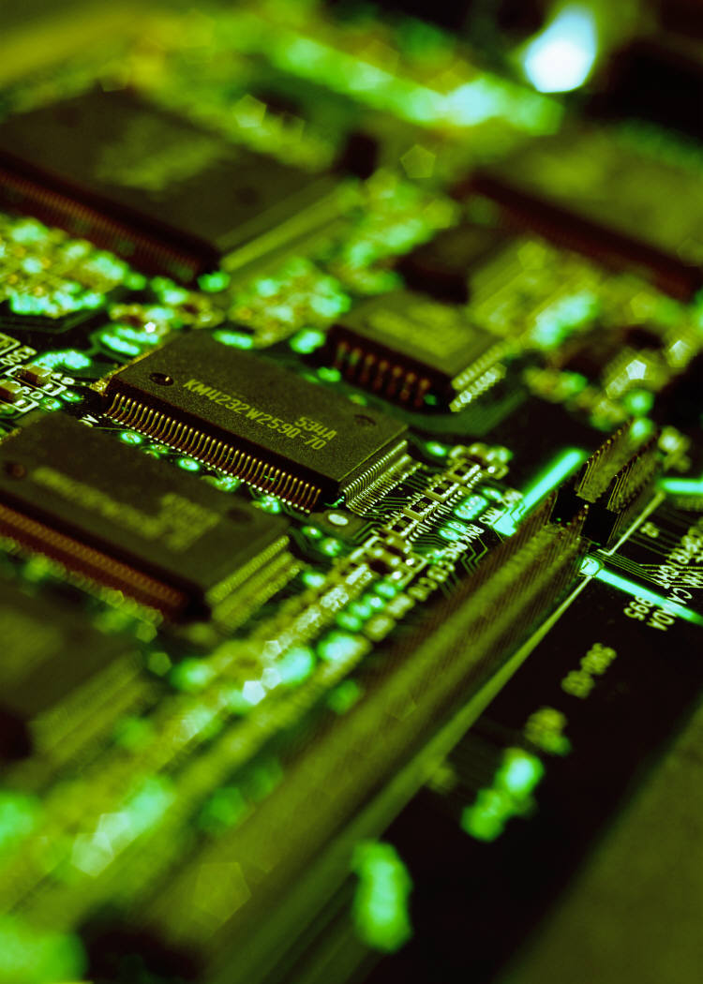
The Death of Moore’s Law?
Moore’s Law is possible because the distance between the pathways inside silicon chips gets smaller with each successive generation.
Fabs: Semiconductor fabrication facilities
Silicon wafer: Thin, circular slice of material used to create semiconductor device
Packing pathways tightly together creates problems associated with size, heat, and power.

Slide 21
The Death of Moore’s Law?
Chip starts to melt when the processor gets smaller.
Need to cool modern data centers draws a lot of power and that costs a lot of money.
Quantum tunneling kicks in when chips get smaller .

Slide 22
Buying time
Multicore microprocessors: Contain two or more calculating processor cores on the same piece of silicon.
Multicore chips outperform a single speedy chip, while running cooler and drawing less power.
Now mainstream, most PCs and laptops sold have at least a two-core (dual-core) processor.
Can run older software written for single-brain chips by using only one core at a time.
Firms are radically boosting speed and efficiency of chips.
Taking chips from being paper-flat devices to built-up 3-D affairs.
Transistors: Super-tiny on-off switches in a chip that work collectively to calculate or store things in memory.

Slide 23
Learning objectives
Understand the differences between supercomputing, grid computing, cluster computing, and cloud computing.
Describe how grid computing can transform the economics of supercomputing.
Recognize that these technologies provide the backbone of remote computing resources used in cloud computing.
Understand the characteristics of problems that are and are not well suited for parallel processing found in modern supercomputing, grid computing, cluster computing, and multicore processors. Also be able to discuss how network latency places limits on offloading computing to the cloud.

Slide 24
A melding of minds
Supercomputers: Computers that are among the fastest of any in the world at the time of their introduction.
Supercomputing was once considered the domain of governments and high-end research labs.
Modern supercomputing is done by massively parallel processing: Computers designed with many microprocessors that work together, simultaneously, to solve problems.
Grid computing: Uses special software to enable several computers to work together on a common problem as if they were a massively parallel supercomputer.
Cluster computing: Connecting server computers via software and networking so that their resources can be used to collectively solve computing tasks.

Slide 25
A melding of minds
Multicore, massively parallel, grid, and cluster computing are all related.
Each attempts to lash together multiple computing devices so that they can work together to solve problems.
Software as a service (SaaS): Form of cloud computing where a firm subscribes to a third party software and receives a service that is delivered online.
Cloud computing: Replacing computing resources with services provided over the Internet.
Server farms: Massive network of computer servers running software to coordinate their collective use.
Latency: Delay in networking and data transfer speeds.
Low latency systems are faster systems.
Moore’s Law will likely hit its physical limit soon, but still-experimental quantum computing could make computers more powerful.

Slide 26
Supercomputers in Action
http://youtu.be/XShMSu68QPc
https://en.wikipedia.org/wiki/Watson_(computer)
Notes:
Video on IBM Watson at RPI

Slide 27

Learning Objectives
Understand the magnitude of the environmental issues caused by rapidly obsolete, faster, and cheaper computing.
Explain the limitations of approaches attempting to tackle e-waste.
Understand the risks firms are exposed to when not fully considering the lifecycle of the products they sell or consume.
Ask questions that expose concerning ethical issues in a firm or partner’s products and processes, and that help the manager behave more responsibly.

Slide 28
E-waste
Discarded, often obsolete technology associated with negative externalities
May be toxic since many components contain harmful materials such as lead, cadmium, and mercury.
It also contains small bits of increasingly valuable metals such as silver, platinum, and copper.
Requires recycling, which is extremely labor intensive.
Most of the waste is exported for recycling

Slide 29
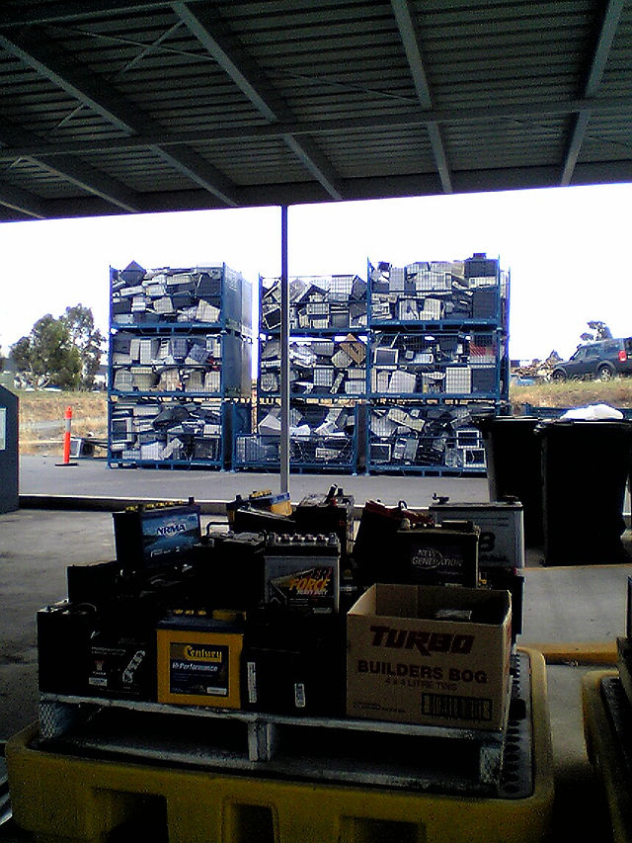
E-waste
Managers must consider and plan for the waste created by their:
Products, services, and technology used by the organization.
Managers must audit disposal and recycling partners with the same vigor as their suppliers and other corporate partners.

Slide 30
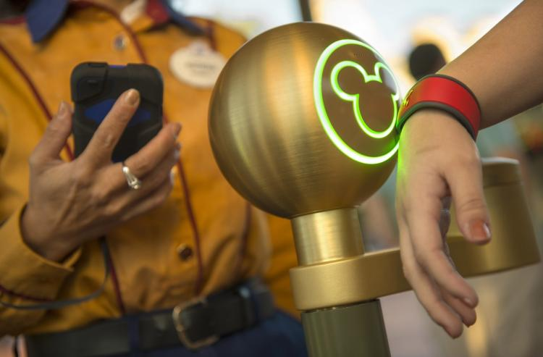
Learning objectives
Illustrate the value that Disney accrued from embedding technology in otherwise manual experiences.
Recognize how the experience improved the value of the customer’s Disney World experience.
Understand some of the issues involved in deploying large-scale information systems in a corporate environment.

Slide 31
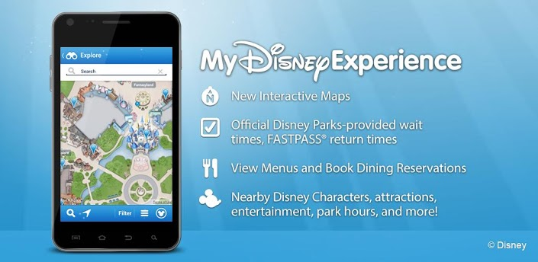
MyMagic+
Disney has streamlined your experience to delight you and therefore keep you spending.
The centerpiece is the MagicBand, which allows keyless entry to your hotel room, pay for rides, locate you to deliver restaurant meals, personalized greetings, etc…
MyDisneyExperience website and mobile app allow consumers to plan, share, and manage their itinerary.

Slide 32
Big Data and big benefits
Big data analytics and efficient scheduling algorithms keep everyone happier.
MyMagic+ books ride reservations to minimize wait and spread out guests to further cut line time.
Data helps Disney know:
When to add more staff at rides or restaurants
How to stock restaurants, snack bars, and souvenir stands
How many costumed cast members are needed in different parts of the park
They have cut turnstile transaction time by 30%
Guests spend more money
Able to serve 3,000 to 5,000 additional guests per day

Slide 33
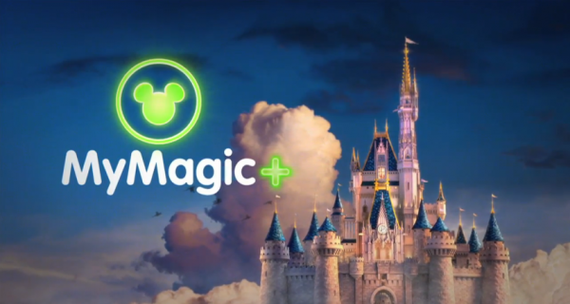
Big cost and magical coordination
MyMagic+ cost roughly $1 billion
Requiring over 100 systems be integrated
Employees needed new training
Many internal and external groups were involved. Differing opinions and agendas often make large projects politically challenging to coordinate.
The CEO led the effort, and senior executives from various groups tasks to lead development, helped reduce debilitating infighting and helped the project come in under budget.

Slide 34
Chapter 6
Disruptive TECHNOLOGIES: understanding the giant killers and TACTICS for avoiding extinction

Slide 35

Learning objectives
Identify the two characteristics of disruptive innovations.
Understand why dominant firms often fail to capitalize on disruptive innovations.
Suggest techniques to identify potentially disruptive technologies and to effectively nurture their experimentation and development.

Slide 36
Characteristics of Disruptive Technologies
They come to market with a set of performance attributes that existing customers do not value.
Over time the performance attributes improve to the point where they invade established markets.
Performance demanded at the high end of the market
Product Performance
Incumbent market leader
Disruptive innovation
Performance demanded at the low end of the market
Time
Source: Adapted from C. Christensen, The Innovator’s Dilemma. Harvard Business School Press, 2013.

Slide 37

Why big firms fail
Failure to see disruptive innovations as a threat.
Reason: They do not dedicate resources to developing the potential technology since these markets do not look attractive.
Creates blindness by an otherwise rational focus on customer demands and financial performance.
Start-ups amass expertise quickly.
Big firms are forced to play catch-up.
Few ever close the gap with the new leaders.

Slide 38
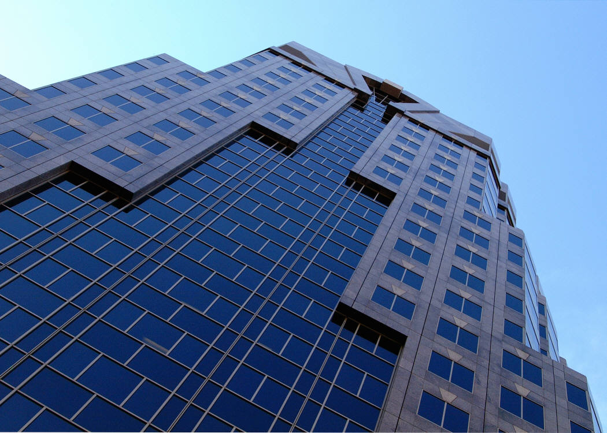
Recognizing Potentially Disruptive Innovations
Remove short-sighted, customer-focused, and bottom-line-obsessed blinders.
Have conversations with those on the experimental edge of advancements.
Increase conversations across product groups and between managers and technologists.
If employees are quitting to join a technology, it might be worth considering.

Slide 39
When a Potential Disruptor is Spotted
Build a portfolio of options on emerging technologies, investing in firms, start-ups, or internal efforts.
Focus solely on what may or may not turn out to be the next big thing.
Options give the firm the right to continue and increase funding as a technology shows promise.
If a firm has a stake in a start-up, it may consider acquiring the firm.
If it supports a separate division, it can invest more resources if that division shows promise.
Encourage new market and technology development.
Focus while isolating the firm from a creosote bush-type of resource sapping from potentially competing cash-cow efforts.

Slide 40

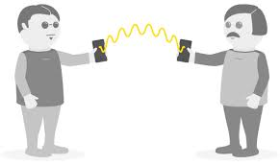
Learning objectives
Understand what bitcoin is, to whom it appeals and why, its strengths, and its limitations.
Gain additional insights into evaluating the trajectory of technology and its disruptive capacity.

Slide 41
Bitcoin: a disruptive innovation for money and more?
Bitcoin: An open-source, decentralized payment system that operates in a peer-to-peer environment, without bank or central authority.
Benefits:
Eliminates transaction fees
Used for international commerce without delay or transaction fees
Straddles the line between transparency and privacy
Concerns:
Difficult to understand/use technology
Has bad reputation (drug dealers, tax evaders, etc…)
Security
Volatility of the value of a bitcoin

Slide 42
Managing IT Resources This Week’s Remaining Assignments
Work with Team on selecting Client and Project Topics
Review Sept 13 Slide Presentation prior to Class on Sept 13 including the In-Class CBA Exercise
Review Cost-Benefit Analysis Examples on LMS
Prepare to Complete and Submit Cost-Benefit Analysis Exercise done in Class on Sept 13
Each Team submit Term Project Proposal by EOD: 11:59 pm on Thursday Sept 13

